Slide 1

Deep Learning Architecture for diabetic retinopathy categorization
based on segmented fundus image characteristics
Team members: 123003286-Garlapati Dhanalakshmi
123003047-Chappidi Manogna
123003243- Suggula Jyothsna
Guide :
Prof. Prabaharan L

Slide 2
Problem Statement
Diabetes retinopathy is caused by elevated blood sugar levels. Too much sugar in your blood can damage your retina over time, which is the area of your eye that is responsible for vision. The purpose of DR screening is to identify people with sight-threatening DR , so that they are treated promptly to prevent blindness. Hence, we propose a CNN-based approach for DR screening.

Slide 3
Steps Involved
Reading Fundus Images
Image Preprocessing
Image Segmentation
Training Convolution Neural Network (CNN) model
Classifying Output (Abnormal / Normal)
IMPLEMENTATION PLATFORM : MATLAB 2018b

Slide 4
Related Works
AUTHOR | WORK | EVALUATION
Gehad | Proposed a blood vessel segmentation approach | Accuracy : 95.10%
Memari | An automatic retinal vessel segmentation that utilizes fuzzy c-means clustering and level sets | Accuracy : 96.10%
Budai | A method is proposed to reduce calculation time, that achieves high accuracy and increase sensitivity against the Frangi method. Two datasets: DRIVE,STARE | Accuracy : 95.72% (DRIVE DATASET) Accuracy : 93.86% (STARE DATASET)
Shailesh | An improved blood vessel detection technique by morphological iterative process and develops an automated Optic Disc algorithm. | Sensitivity : 87% Specificity : 93%

Slide 5
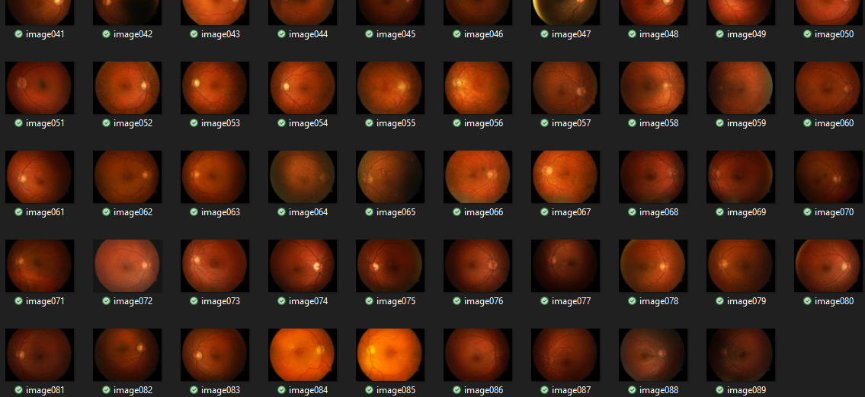
Data Set
DIARETDB1 Data set
Data set link : https://www.kaggle.com/datasets/nguyenhung1903/diaretdb1-standard-diabetic-retinopathy-database

Slide 6
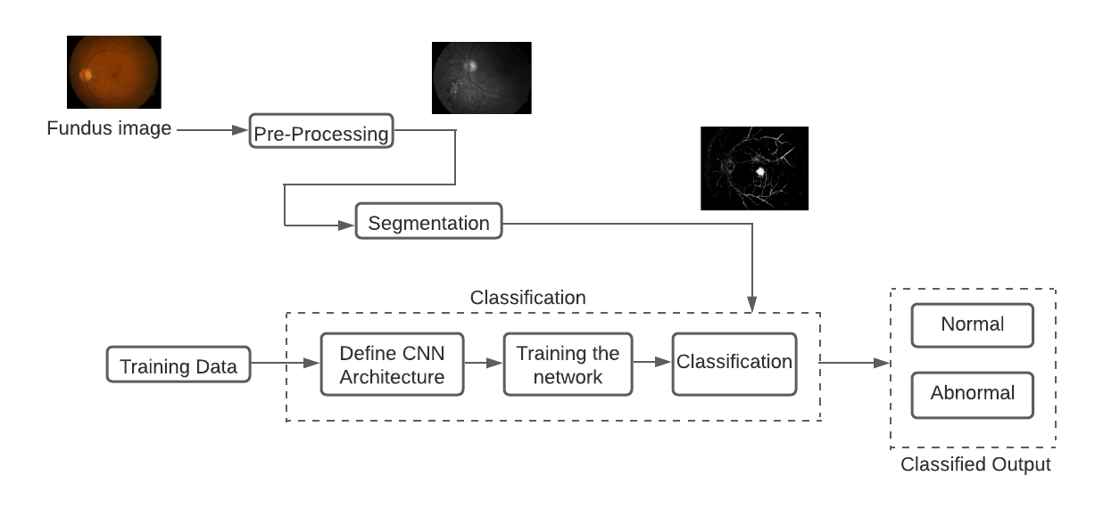
Work flow

Slide 7
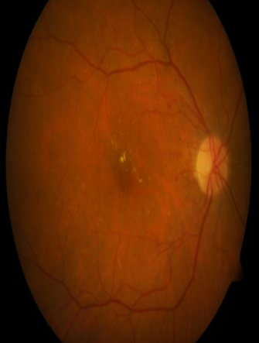
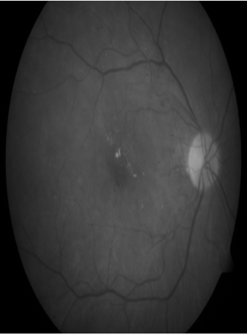
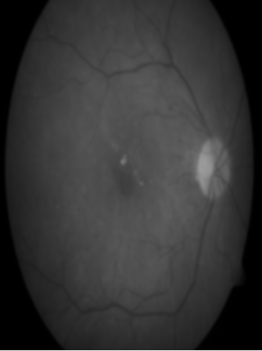
Reading image and preprocessing
First we read the input fundus images from the DIARETDB1 dataset and load to our workspace.
Performing appropriate reshaping of image and we convert color image to grayscale lab image.
Next, we are smoothing the image using Gaussian filter.
Original
Grey Scale
Gaussian filter

Slide 8

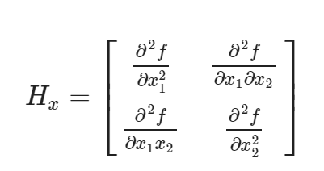
Gaussian Filter :It's a filtering technique that reduces the amount of noise in an image. Smoothing is done by blurring the image using a function called Gaussian function or Gaussian Blur.
Hessian Matrix: A square matrix of second-order partial derivatives of a scalar-valued function or scalar field is referred to as a Hessian.

Slide 9
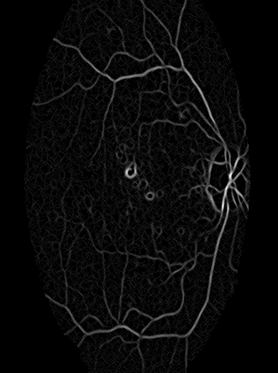
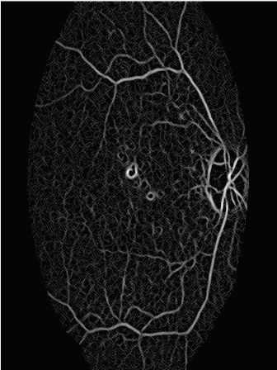
Image Segmentation
Maximum Principal Curvature: The dark lines/edges on the light background are detected by maximum principal curvature. The eigen values of the Hessian for a particular pixel can be used to calculate principal curvature.
Adaptive Histogram Equalization : Adaptive Histogram Equalization is technique used to improve contrast in image and enhance the definitions of edges in each region of an image.

Slide 10
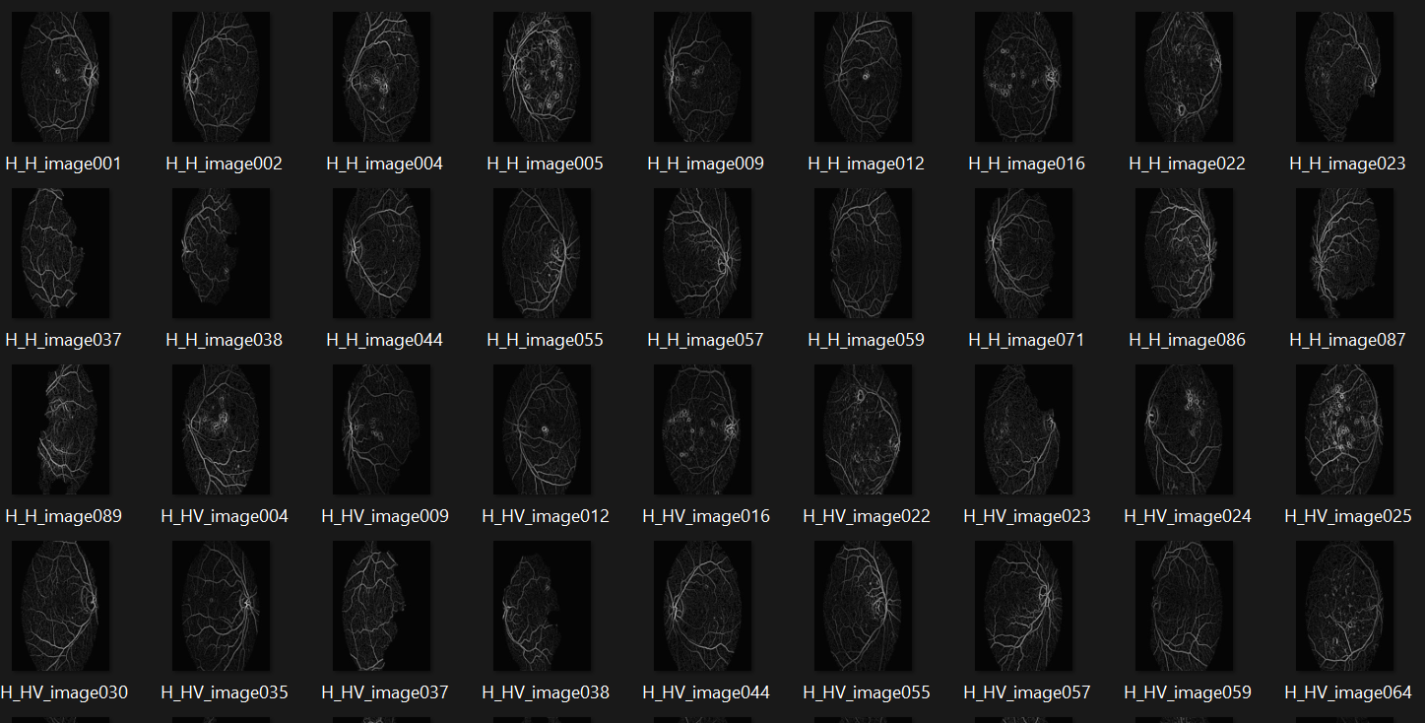
Images after AHE

Slide 11
Image Segmentation
Segmentation is the process of retinal partitioning a digital image into multiple regions and extracting the significant ones. There are many image segmentation techniques, in this project thresholding segmentation is applied.
Thresholding Segmentation :
Threshold segmentation divides the pixels in an image by comparing the pixel’s intensity with a specified value (Threshold) . It is useful when the required object has a higher intensity than the background (unnecessary parts).
The thresholding method converts a grey-scale image into a binary image by dividing it into two segments.(Required and not required sections).
In this method you replace the image’s pixels with either white or black. If the intensity of a pixel at a particular position is less than the threshold value , you’d replace it with black .

Slide 12
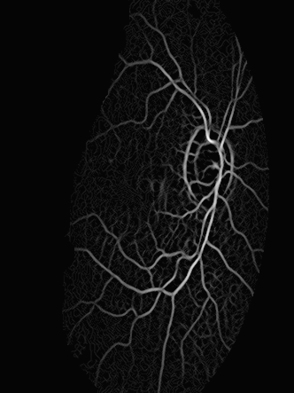
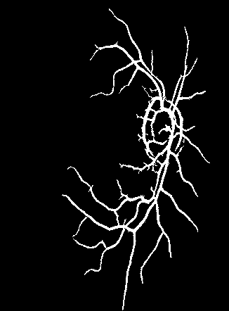
If the intensity is higher than the threshold value you’d replace it with white.
Obtained binary image also contains noise, in order to remove the noise morphological opening is performed to remove the noise and to obtain clear segmented image.
Morphological Opening uses a structural element which focus on shape and size of larger objects and ignores smaller objects.
Segmented images are trained to the CNN model for classification

Slide 13
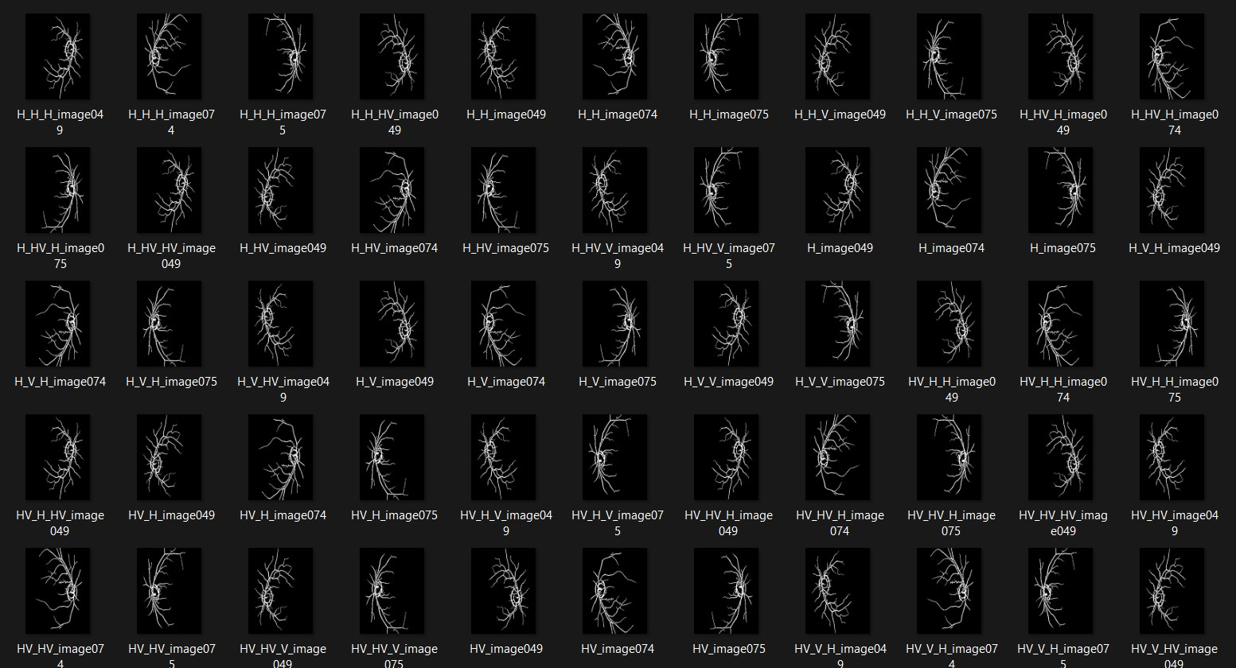
Images after Segmentation

Slide 14
Convolution Neural Network
A Convolution Neural Network is a deep learning algorithm which can take in an input image, assign importance to various aspects/objects in the image and be able to differentiate one from another
CNN make use of filters (also known as kernels) to detect what features such as edges are present throughout the image.
There are four main operations in an CNN:
Convolution
Non Linearity (ReLU)
Pooling
Classification (Fully Connected Layer)

Slide 15
Convolution :
Convolution layers apply a convolution operation to the input, passing the result to the next layer. A convolution converts all the pixels in its respective field into a single value. The final output of the convolution layer is a vector.
ReLU :
The rectified linear activation is a piecewise linear function that will output the input directly if its positive otherwise it will output zero. It has become the default activation function for many types of neural networks because a model that uses it is easier to train and often achieves better performance.
Pooling:
Pooling layers are similar to convolution layers but they perform a specific function such as max pooling , min pooling, average pooling etc to reduce the dimensionality of the network.

Slide 16
Max Pooling : Takes the maximum value in a certain filter region.
Min Pooling : Takes the minimum value in a certain filter region.
Average Pooling : Takes the average value in a certain filter region.
Fully Connected Layer:
Fully Connected layers connect every neuron in one layer to every neuron in another layer. It is same as a traditional multi-layer perceptron neural network. The flattened matrix goes through a fully connected layer to classify the images.
Batch Normalization Layer:
Batch normalization is a layer that allows every layer of the network to do learning more independently. It is used to normalize the output of the previous layers. The activations scale the input layer in normalization

Slide 17
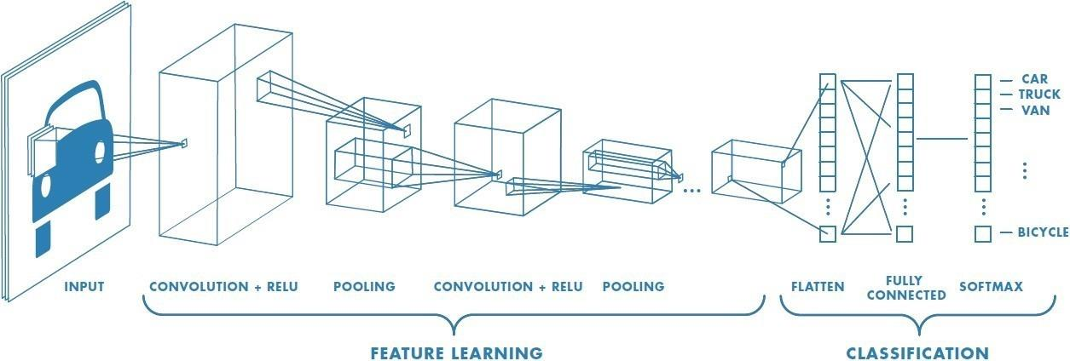
Soft max Layer:
Soft max layer converts the output of the last layer in a neural network into probability distribution. It is normally applied to the very last layer in a neural network.
Classification Layer:
Classification layer infers the number of classes from the output size of the previous layer.

Slide 18
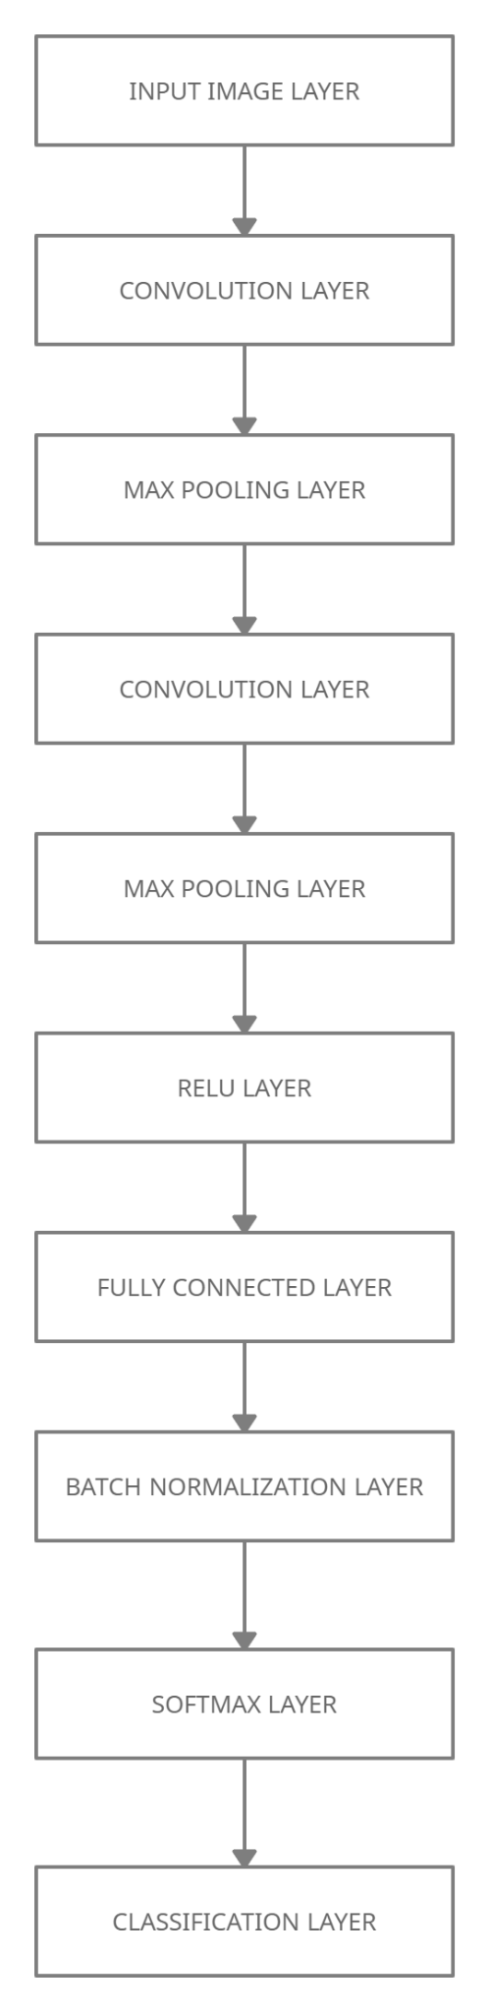
CNN Architecture

Slide 19
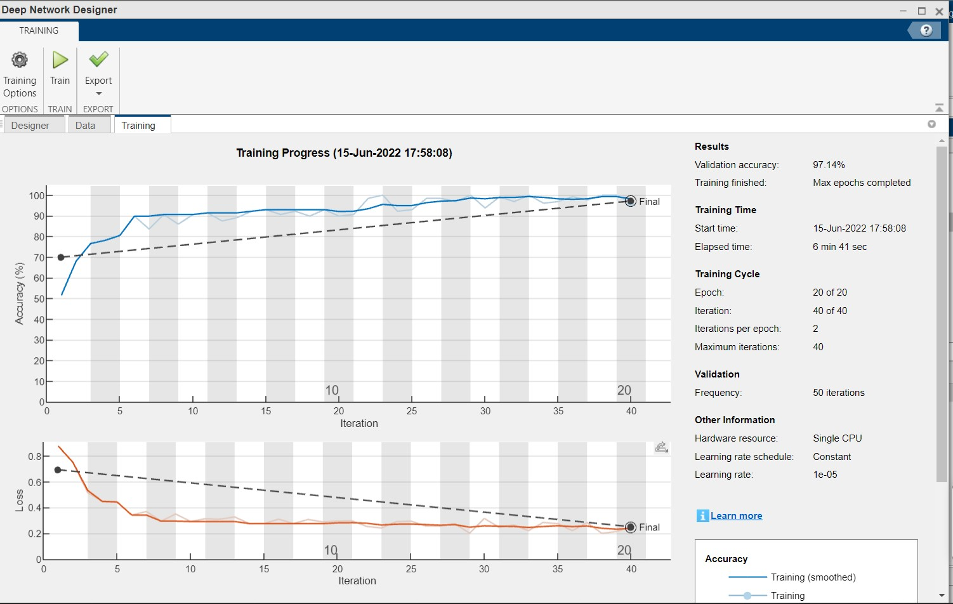
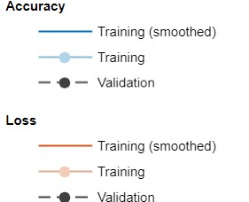
Trained Model Result

Slide 20
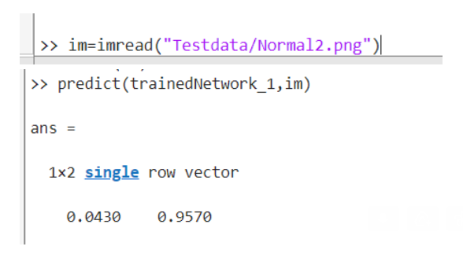
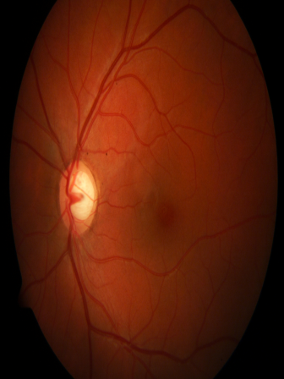
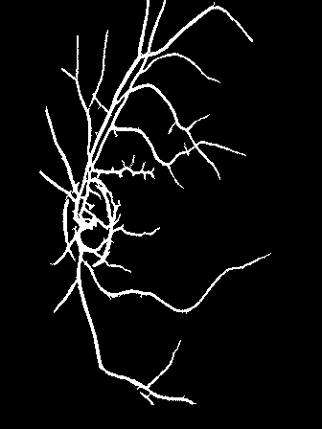
Original Normal2.png
Normal2.png

Slide 21
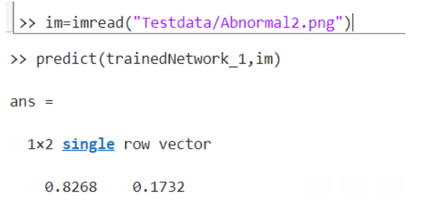
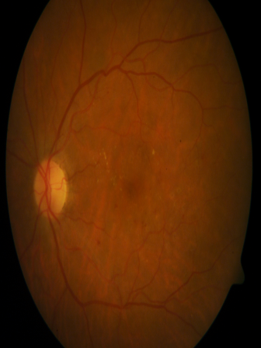
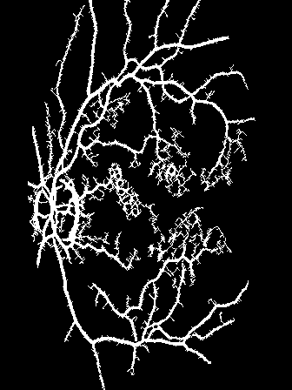
Original Abnormal2.png
Abnormal2.png

Slide 22
Work Plan
Week 1-4 | Literature survey | All team members
Week 5-6 | Pre-processing | G Dhana Lakshmi C Manogna
Week 7-8 | Segmentation | G Dhana Lakshmi S Jyothsna
Week 9-10 | Detection and Classification | C Manogna S Jyothsna

Slide 23
Conclusion
This project proposes a Diabetic Retinopathy detection and classification algorithm that uses CNN. Blood clots/blobs and abnormal growth of blood vessels can be observed in the fundus of patients suffering from DR. This method initially pre-processes the images and the branching blood vessels are extracted through maximum principal curvature segmentation process. Adaptive histogram equalization, morphological opening, are performed to enhance and eliminate the falsely segmented regions.
Further a CNN model is created and tested with a test image and it classifies the labels as the output.

Slide 24
References
Hassan, G., El-Bendary, N., Hassanien, A. E., Fahmy, A., & Snasel, V. (2015). Retinal blood vessel segmentation approach based on mathematical morphology. Procedia Computer Science, 65, 612-622.
Orlando, J. I., Prokofyeva, E., & Blaschko, M. B. (2016). A discriminatively trained fully connected conditional random field model for blood vessel segmentation in fundus images. IEEE transactions on Biomedical Engineering, 64(1), 16-27.
Memari, N., Ramli, A. R., Saripan, M., Mashohor, S., & Moghbel, M. (2019). Retinal blood vessel segmentation by using matched filtering and fuzzy c-means clustering with integrated level set method for diabetic retinopathy assessment. Journal of Medical and Biological Engineering, 39(5), 713-731.
Kumar, N. S., & Radhika, Y. (2019). Optimized maximum principal curvatures based segmentation of blood vessels from retinal images. Biomedical Research, 30(2).

Slide 25
THANK YOU

